Slide 1



Slide 2


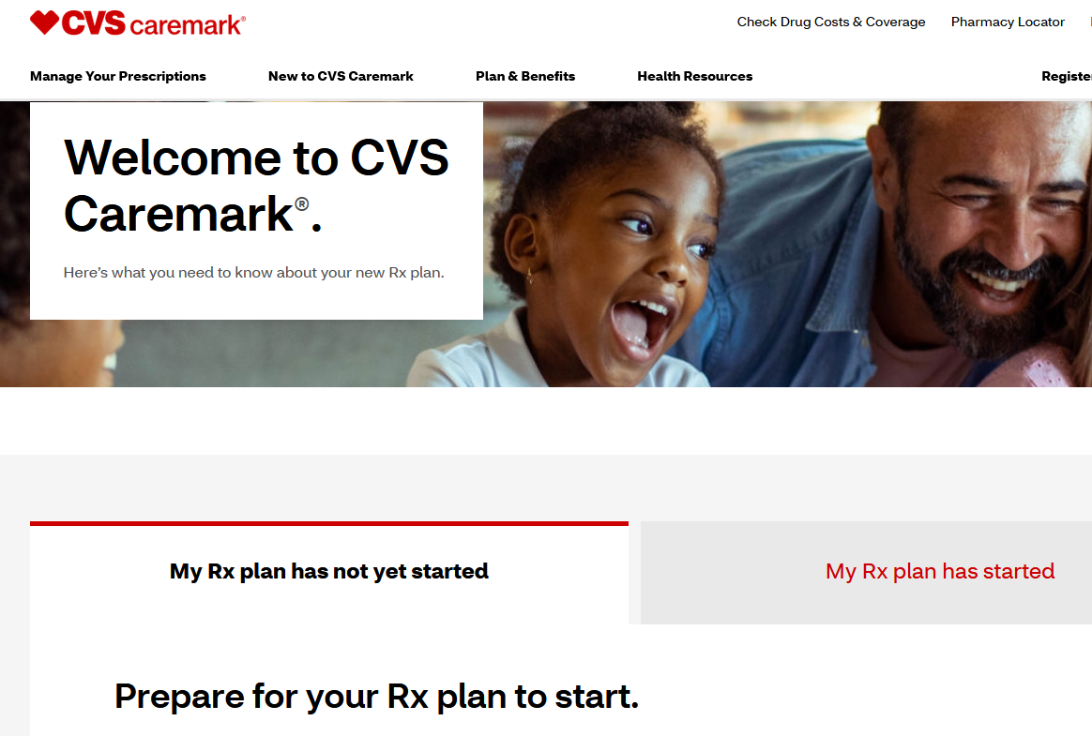


Welcome Center
Be sure to visit the CVS Caremark Welcome Center today to proactively learn more about your new prescription benefits!
Gather information on prescription delivery options
Learn how to register at caremark.com
Discover the check drug cost and coverage tool
Review frequently asked questions

Slide 3
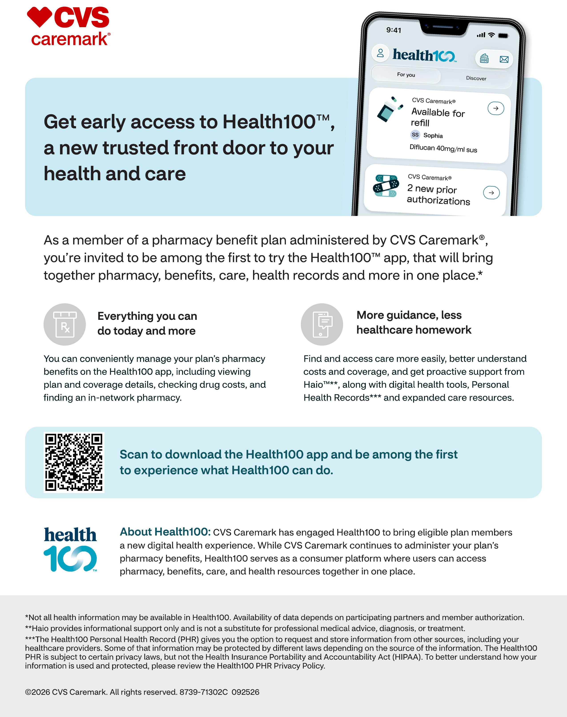

Slide 4
Pharmacy Benefit Resources
National network of 65,000+ pharmacies including all major chains
(e.g. Walgreens, Walmart, Rite Aid, Costco, CVS)
24/7 customer care support starting on or after your benefit effective date
  Telephone lines, website, mobile application
  Have your ID number/card available when calling
  1-866-818-6911
Retail, delivery, mail and specialty pharmacy services
Notes:
Reminder- You can get a 90 day supply of your maintenance medication for 1 copay at a CVS or via mail order. It’s a great option and saves you trips to the pharmacy
Please remember to use your CVS card at the pharmacy. CVS will not be able to locate you in the system if you are trying to use your medical card.

Slide 5
Formulary
The formulary is a list of common covered drugs and a tool to help you and your health care provider determine your lowest-cost treatment options.
The formulary is updated throughout the year as new drugs become available and drug prices change.
If your medication is not on the formulary, you may need a prior authorization.
If your provider thinks there is a clinical reason why the drugs on the formulary will not work for you, they may submit an ePA or call CVS Caremark® toll-free at 1-855-582-2026 to request a formulary exception prior authorization. Approved formulary exception prior authorization requests will be subject to a non-preferred (tier 3) cost share/copay.
Notes:
I will be sharing this presentation with Melissa-the next slide includes your plans formulary list that you can view anytime

Slide 6
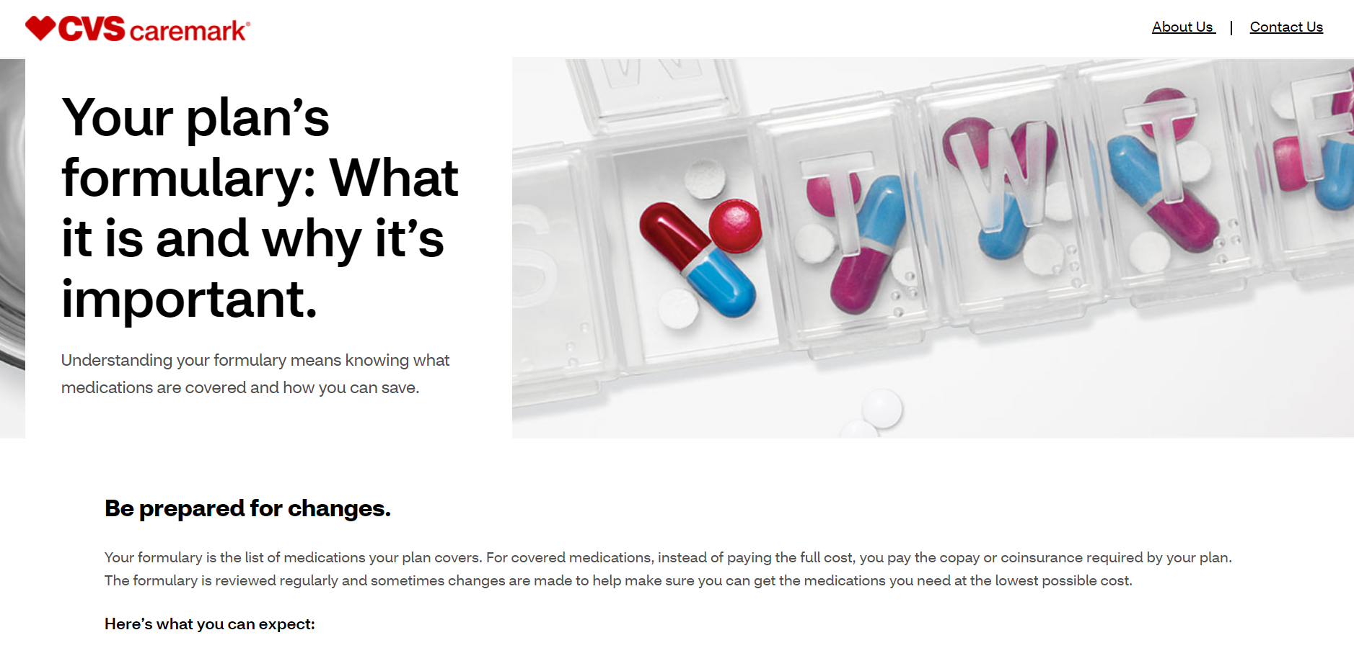
Formulary
You and your health care providers can learn more about covered options at caremark.com.
The formulary list is also available online: https://info.caremark.com/dig/acdruglist. Use the “View your formulary” section in the middle of the page. Click the links labeled view your plan’s current/future formulary.
Generic medications appear in lower case italics (tier 1)
  Preferred BRAND medications appear in all caps (tier 2)
  Non-preferred BRAND medications will not appear on the list (tier 3)
  List of select excluded products begins on page 7

Slide 7
Prior Authorizations and Appeals
Contact Information
Non-Specialty Medications
Caremark Prior Authorization Department
Phone: 1-800-294-5979
Fax: 1-888-836-0730
Appeals may be submitted in writing via fax or mail to:
Prescription Claim Appeals MC 109 CVS Caremark
P.O. Box 52084
Phoenix, AZ 85072
Fax: 1-866-443-1172
Specialty Medications
National CooperativeRx Prior Authorization Department
Phone: 1-608-416-8702 or 1-877-205-6592
Fax: 1-866-278-8190
Appeals may be submitted in writing via fax or mail to:
National CooperativeRx Prescription Claim Appeals
2418 Crossroads Drive, Suite 2600
Madison, WI 53718
Fax: 1-866-278-8190

Slide 8
Digital Tools
Register at caremark.com or download the mobile app for access to helpful tools and resources.
ID Card: No need to carry your pharmacy benefit ID card — it can be accessed via the app
Mail Service Tools: Check order status, order refills and view your prescription history
Check Drug Costs: Determine drug costs and coverage under your plan
Pharmacy Locator: Find in-network retail pharmacies near you
Check Drug Coverage: Formulary, formulary alternatives, prior authorizations

Slide 9


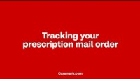
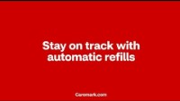
Mail Service Overview & Tools
Getting Started
Overview
Order Tracking
Automatic Refills

Slide 10
Mail Service Enrollment Options
1
Create an account at caremark.com and request a new prescription with mail service from your caremark.com dashboard by selecting “Start Rx Delivery by Mail” from the Prescriptions heading.
CVS Caremark® will contact your prescriber for a new prescription. Have prescription and prescriber information available.
2
Call toll-free number 1-866-818-6911 on or after your benefit effective date
Speak with a customer service representative and let them know you would like to get set up with mail service. They will contact your prescriber for a new prescription. Have prescription and prescriber information available when calling.
3
Prescriber calls toll-free number 1-800-378-5697 or sends new electronic prescriptions to CVS Caremark® Mail Service (NCPDP ID: 0322038) on or after your benefit effective date
You will still need to contact mail service by phone to set up billing and shipping information.
4
Access caremark.com (no account needed)
Visit caremark.com and click on the help center link at the top right corner of the page. From there, hover over “Prescriptions” in the toolbar and select print plan forms. Complete mail order form, print, and mail it in with your hard copy prescription on or after your benefit effective date. Allow at least 14 days for processing.

Slide 11
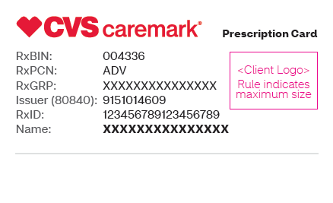
ID Cards for New Plan Participants
Bring your new ID card with you when you fill prescriptions after your effective date
  Don’t have your ID card? No problem! Create an account at Caremark.com to obtain your pharmacy ID number OR ask your pharmacy to call the pharmacy help desk to obtain your ID number.
Your pharmacy benefit ID card has many benefits:
  Provides discounted rates on medications for you and your health plan
  Counts expenses toward your deductible and/or maximum out-of-pocket limits
  Creates a record of your prescriptions
  Enables safety features
Notes:
*If youre already on the plan – no new card. New enrollment- you get a new card. You will get an ID card from CVS and Aetna- please be sure that you are using your CVS card at the pharmacy.

Slide 12
New Plan Participant Enrollment
1
Refill prescriptions before the new benefits takes effect.
Your current plan may limit refills in the last month to 30 days.
Prior authorizations or exceptions from the prior pharmacy benefit provider may not transfer to the new vendor.
Your prescriber can start requesting new prior authorizations/exceptions on your behalf on or after your new benefit effective date.
2
If existing mail order or specialty medication prescriptions are being transferred from the current pharmacy benefit provider to CVS Caremark®, some items cannot be transferred including:
Prescriptions without refills, inactive (e.g. closed or never filled) prescriptions, prescriptions for controlled substances and prescriptions for compounded medications.
3
Notes:
Only applies to new members enrolling-

Slide 13
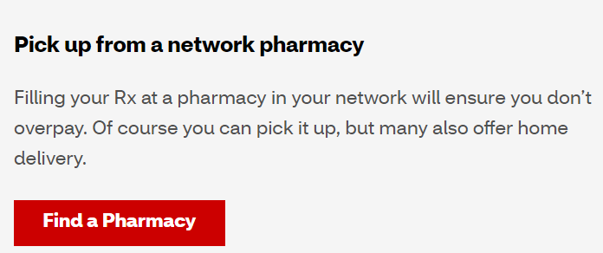
In-Network Pharmacies & Prescription Transfers
  In-network pharmacies can be located at www.caremark.com by using the “Find a Pharmacy” feature in the middle of the webpage.
    The CVS Caremark® prescription network is quite large
    It is not expected you should have to change pharmacies except for mail service or specialty prescriptions
  How to transfer a non-specialty prescription:
    Bring your empty medication container to the pharmacy you want to use
    The new pharmacy will contact the old pharmacy and transfer any refills if allowed and available
    Allow at least 24 hours for prescription transfers
Notes:
**Remind members to use CVS for better pricing- Mail order, retail 90..
Confirm pricing options for members on the website-
Which pharmacies are eligible for a 90 day supply

Slide 14
Specialty Medications
Specialty medications must be filled at CVS Specialty Pharmacy®. If CVS Specialty Pharmacy® does not carry your medication, you may use a different specialty pharmacy. The list of medications CVS Specialty Pharmacy® carries is online. The appearance of a drug name on this list does not imply coverage.
Specialty prescriptions will be limited to a 30-day supply and may require prior authorization. Prior Authorizations (PA) from your prior specialty pharmacy provider may not transfer.
Specialty medication prior authorizations will be processed by National CooperativeRx.
You and your doctor may receive an approval or denial notification. Denial notifications will indicate reason(s) for the denial as well as appeal rights.
Phone: 1-608-416-8702
Fax: 1-866-278-8190

Slide 15
Getting Started with
CVS Specialty Pharmacy®
Have your doctor send a new prescription to CVS Specialty Pharmacy® (NCPDP ID 1466033) OR drop a hard copy prescription at a CVS Pharmacy® on or after your benefit effective date.
1
Review the preferred drugs online: https://info.caremark.com/acsdruglist
Use the “View your formulary” section in the middle of the page. Click the links labeled view your plan’s current/future specialty formulary.
2

Slide 16
Safe
Generic Drugs
Effective
Can Save You and Your Plan Money
Nearly 2 Billion Generic Prescriptions Filled Annually
Easy to Order – Ask Your Doctor to Prescribe Generics When Available

Slide 17
Prevention
These no-cost benefits are part of the Affordable Care Act (ACA)
Medicine and supplements to prevent certain conditions for adults and children
Medicine and products for quitting smoking or chewing tobacco (tobacco cessation)
Medicine used prior to screenings for certain health conditions in adults
Vaccines and immunizations to prevent certain illnesses in infants, children and adults
Contraceptives for women
Notes:
What Vaccines are covered on the Rx side vs Medical

Slide 18
Rx Plan Options and Copays
Prescription Drug Plan
 | HRA, PPO & HMO Plans | HSA Medical Plan
Prescription Drug Plan (Some preventive care drugs are covered at 100%) | $10 Copay Generic $30 Copay Preferred $75 Copay Non-Preferred | $10 Copay Generic $30 Copay Preferred $75 Copay Non-Preferred Individual Plan $1,850.00 Deductible Family Plan $4,900.00 Deductible (An individual within the plan will not exceed $3,500)
Mail Order & Maintenance Choice Pharmacies | 90 day supply for 1 month copay | 90 day supply for 1 month copay
Notes:
Reminder- In a family plan- each individual will max at $3,500. Meaning if one family member- say the spouse, reaches $3,500 before the family reaches the $4,900 deductible, it will be counted as that individual meeting the deductible.
Some members are currently enrolled in the CVS OTC Program- Where they get $55/month to use at CVS- This is changing to ONLY the cardholder gets this benefit

Slide 19
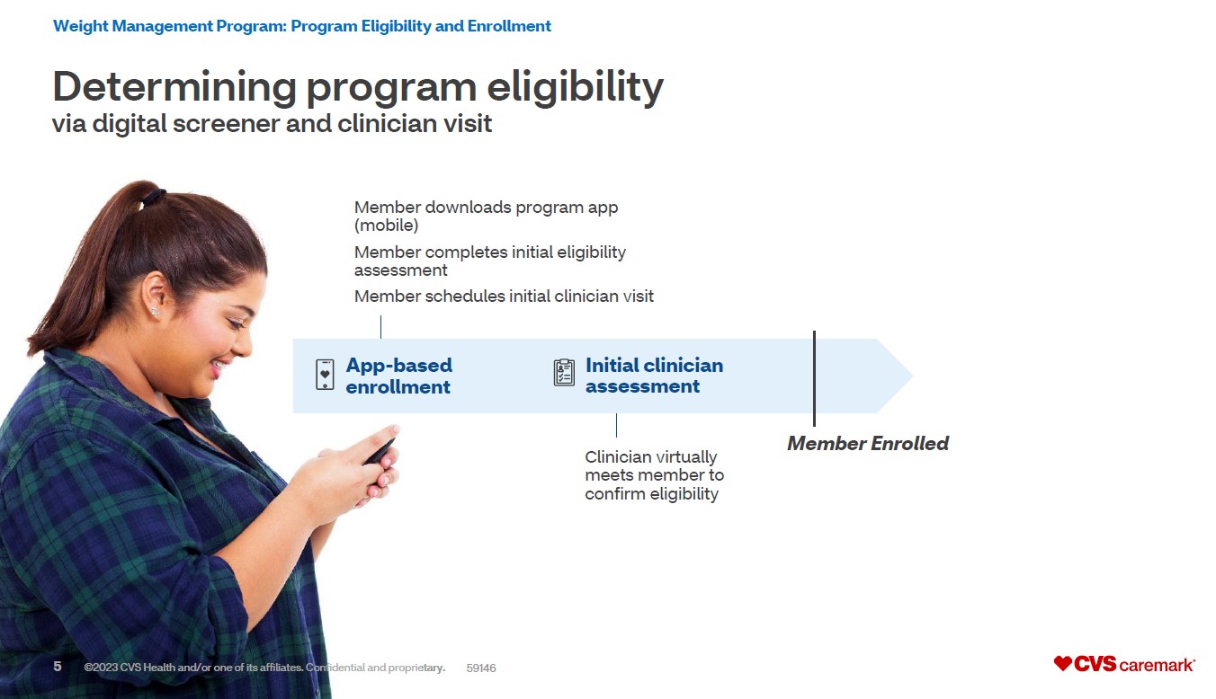
CVS Weight Loss Program
Voluntary
Effective 1/1/2026
CVS Weight Management™ Program – Overview
Purpose: Helps eligible members manage weight and metabolic health through lifestyle changes, clinical support, and medications (e.g. GLP-1s).
Key Features:
  1:1 support with registered dietitians
  Personalized nutrition & behavioral coaching
  Clinical oversight for medication use
  Digital tools (app, connected scale, tracking)

Slide 20
Ways to Save
1
Practice Preventive Care
5
Utilize Formulary/preferred brands
2
Adhere to prescribed medication(s)
3
Utilize Over-The-Counter (OTC) / non-prescription alternatives
6
Set up 90 days’ supply through Mail Service or your local CVS/pharmacy
4
Utilize Generics
Notes:
https://www.hhs.gov/healthcare/about-the-aca/preventive-care/index.html

Slide 21
Questions?
Smartphone Apps (CVS/caremark, CVS/specialty, CVS/pharmacy)
Customer Care 1-866-818-6911
Caremark.com
  Check drug costs and benefits, find local pharmacies
  Ask-A-Pharmacist
  Formulary www.caremark.com/acdruglist
Specialty/Caremark Connect 1-800-237-2767 or www.cvsspecialty.com
Coram CVS Specialty Infusion Services 1-800-423-1411 or www.coramhc.com
ExtraCare Health Card 1-888-543-5938 or cvs.com
Notes:
If you have additional questions that you don’t feel comfortable asking on the call, please feel free to follow up with Melissa and she can reach out to me. Melissa will be sending this slide show out.

Slide 22
Caremark General
Getting to Know Your Prescription Benefits | CVS Caremark – YouTube
Prescription Coverage & Prior Authorizations – YouTube
Stay on Track with Automatic Refills – YouTube
Compare Prescription Costs & Coverage – YouTube
Prescription Coverage & Quantity Limits – YouTube
Prescription Coverage and Your Plan’s Formulary - YouTube
Get to Know the Caremark Digital Tools – YouTube
Caremark Mail Service
Save Time & Get Your Rx Online – YouTube
Tracking your Caremark Mail Service Prescription – YouTube
CVS Specialty Pharmacy
Welcome to CVS Specialty – YouTube
CVS Specialty Coram Home Infusion Services – YouTube
Video Appendix

