Slide 1



Flexible Spending Account (FSA)
O
FSA Open Enrollment beginning 10/13/2026 and ends 10/23/2026*
If completed by 10/16, your name will be entered in a drawing to win $150
Lisa Manuele, BRI, An INSPIRA FINANCIAL SOLUTION
Notes:
Hello. During this presentation, we will cover the details of Flexible Spending Accounts featuring The Beniversal Prepaid Mastercard.

Slide 2
What is an FSA?
Rules determined by Internal Revenue Code (IRC) Section 125
Medical & dependent care accounts and expenses
Contributions not subject to Federal, FICA, & state taxes
FLEXIBLE SPENDING ACCOUNT (FSA)
Notes:
Flexible Spending Accounts, commonly referred to as FSAs, are IRS-approved accounts governed by Internal Revenue Code Section 125 that allow employees to pay for eligible medical and dependent care expenses on a tax-free basis. When employees enroll in an employer-sponsored Flexible Spending Account, contributions are not subject to Federal, FICA, and most state taxes. This means by enrolling, employees bring home more money in their paycheck.

Slide 3
How it Works
1
During Open Enrollment, make separate annual elections for each FSA you wish to enroll in.
Your annual election will be taken before tax throughout the year based on your bi-weekly payroll schedule.
You will have access to your election throughout the plan year for eligible expenses until the date allowed by your plan.
  MEDICAL FSA
  DEPENDENT CARE FSA
2
3
Note: If you or your spouse are contributing to an HSA (Health Savings Account), you cannot enroll in the General Medical FSA.
Notes:
Prior to the start of the plan year, you will have an open enrollment period, and will make separate annual elections for each type of FSA that you wish to enroll in. Accounts must be elected separately, and funds cannot be transferred between accounts. Your annual election will be taken before tax throughout the year based on your payroll schedule. Your FSA balance can be used throughout the plan year to pay for eligible expenses until the specific date allowed by your plan.

Slide 4
Plan Information
PLAN YEAR: 1/1/2027 to 12/31/2027
PLAN LIMITS:
  MEDICAL FSA: Maximum $3,400*
  DEPENDENT CARE FSA: Maximum $7,500
DEADLINE FOR SUBMITTING 2026 CLAIMS: 3/31/2027
Any remaining 2026 balance after 3/31/2027 is forfeited.
Enroll Through Your Employer
* Awaiting the IRS maximum Limit announcement which may increase the limit.
Notes:
The 2027 plan limits defined by the IRS will not be available at the time of your enrollment. When completing your enrollment in UKG, you will only be allowed to elect up to the 2026 plan year limits. If you elect the 2026 max contribution limit during OE, HR will contact you once the 2027 IRS limits have been released to inquire if you want to increase your election to the 2027 contribution maximum.

Slide 5
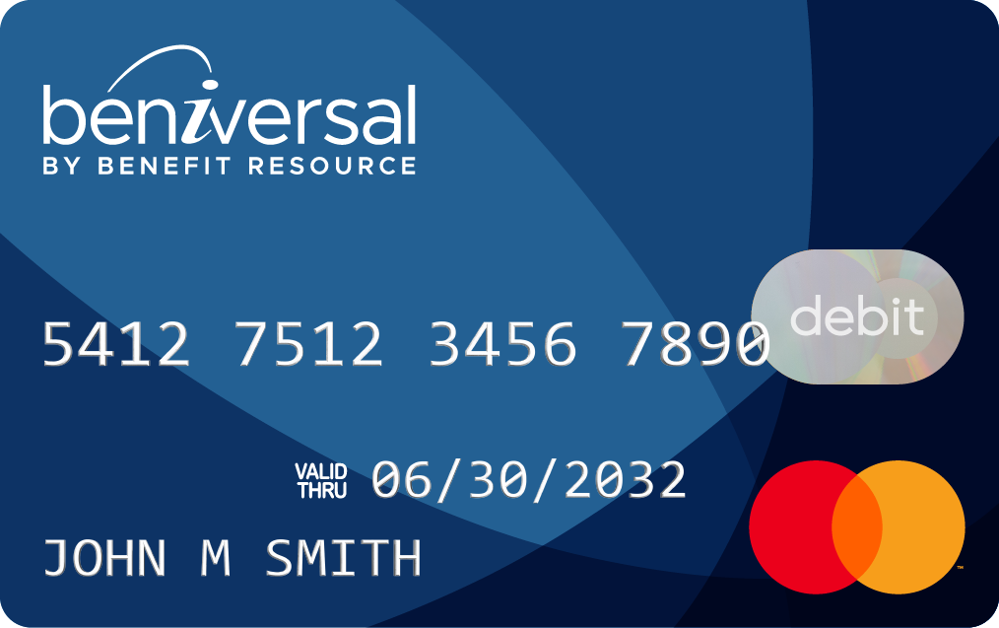
How Does a Medical FSA Work?
Your entire Medical FSA election will be available on the first day of the plan year.
You use the FSA funds for eligible medical expenses provided for you, your spouse and any dependents.
Use your Beniversal® Prepaid Mastercard®
Submit claims
Notes:
Now let’s dive a little deeper into the details of how a medical FSA works. With a medical FSA, your entire annual election amount will be available to you on the first day of the plan year. The funds in your account can be used to pay for eligible medical expenses for you, your spouse, and your dependents. To access the funds, you can pay with your Beniversal Prepaid Mastercard, or you can pay out of pocket and submit a claim to BRI for reimbursement.

Slide 6
Example Medical FSA Expenses
Out-of-Pocket Medical Expenses
OTC Medical Devices & Supplies
OTC Drugs & Medicines
Related Medical Services
Co-payments, deductible expenses,
co-insurance, prescription drugs
Dental & vision care, chiropractic care, counseling services
Birth control, first aid supplies, health monitors, insulin and diabetic supplies
Acne, allergy & sinus, cold & flu, and pain relief medications
Visit BenefitResource.com/resources/eligible for a comprehensive list & lookup tool.
Notes:
Example eligible medical expenses include any out-of-pocket medical expenses tied to an employer health plan. This includes co-payments, deductible expenses, co-insurance, and prescription drug costs. It also covers other medical services that may not be included in your health plan such as dental, vision, chiropractic, or counseling services.
Many over-the-counter items are eligible as well. Some examples of over-the-counter medical devices and supplies that are eligible include birth control, first aid supplies, Health monitors, insulin and diabetic supplies, and more. Some examples of eligible over-the-counter drugs and medicines include acne medications, allergy and sinus medications, cough cold and flu medicines, pain relief medications, and more.
For a more comprehensive list of what’s eligible as well as an eligible expense lookup tool, visit the Eligible Expenses page at BenefitResource.com.

Slide 7

Get Your Card
Your card will be mailed to your home address in a plain white envelope.
Activate it by calling the number on the activation label or online at BRIWEB.
Use card year-to-year.
Choose “credit” not debit unless you use a PIN.
Cards are automatically replaced 50 days prior to the expiration date.
If lost or stolen, call Participant Services or report online.
The Beniversal Prepaid Mastercard is issued by The Bancorp Bank, N.A., Member FDIC, pursuant to a license by Mastercard International Incorporated and may be used for eligible expenses everywhere Mastercard is accepted. Mastercard is a registered trademark, and the circle’s design is a trademark of Mastercard International Incorporated.
Notes:
Upon enrollment in a Medical FSA or a carded Dependent Care program, you will receive two Beniversal cards - one for your personal use and one for a spouse or eligible dependent. These will be mailed to your home address. To activate these cards, you can either call the number on the activation label or log into your BRIWEB account. We encourage you to read the instructions that are included in your card mailing.

Slide 8
Use Your Card at Qualified Merchants
  Qualified healthcare-related merchants
  (e.g., hospital, doctor, dentist, vision, etc.)
  Qualified merchants using inventory identification approval system (IIAS)
  (e.g., most major drug stores, pharmacies, and major box stores that have a pharmacy department)
  Drugstores or pharmacies without inventory identification system
  (referred to as 90% merchants)
Visit BenefitResource.com/resources/card for more information on how the card works.
Notes:
Once activated, your Beniversal cards can be used at qualified Merchants. Some examples of qualified healthcare merchants include hospitals, doctor’s offices, and dental and vision providers. You can also use it at qualified merchants using the inventory identification approval system, otherwise known as IIAS. These include most major drug stores and pharmacies or major box stores that have a pharmacy department. The cards can also be used at drug stores or pharmacies without IIAS at Merchants which make at least 90% of their revenue from the sale of eligible medical items, often referred to as 90% merchants. Check out the Eligible Expenses page at BenefitResource.com to learn more.

Slide 9
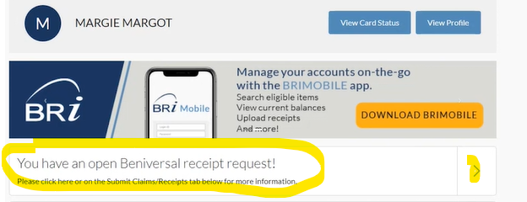
Save All Receipts & Documentation
ALWAYS RETAIN RECEIPTS AND SUPPORTING DOCUMENTS
(e.g., invoices, statements, explanation of benefits)
The IRS requires verification that all pre-tax funds are used for eligible expenses. BRI can verify most transactions. But, when a transaction cannot be verified, a receipt is requested.
You’re more likely to receive a receipt request when purchasing from:
Healthcare providers that provide both eligible services & cosmetic (ineligible) services
90% merchants (90% or more of business revenue is from selling eligible medical items)
Dental and vision care providers
Notes:
An important rule of thumb with an FSA is to save all of your receipts and supporting documents. The IRS requires all TPAs like BRI to verify that funds are used only for eligible expenses. BRI is able to verify most transactions at the point of sale. But in certain situations, you may be asked to provide “documentation support” or receive a “receipt request” via a Beniversal Card Follow-Up Request through a process known as Substantiation. This may happen if you visit a health care provider that provides some cosmetic services not eligible under a pre-tax health account, a 90% merchant such as a local hospital, urgent care, or pharmacy, or a dental or vision care provider.

Slide 10
Medical FSA Receipt Requests
Claim Substantiation
IF ADDITIONAL INFORMATION IS REQUIRED:
BRI will send you an e-mail or a letter within a week of the card transaction.
PROVIDE AN ITEMIZED RECEIPT OR EXPLANATION OF BENEFITS (EOB) CONTAINING:
Name of Provider | Patient Name | Type of Service | Date of Service | Cost After Insurance
THREE WAYS TO RESOLVE RECEIPT REQUESTS:
Through BRIWEB, Mobile APP or USPS mail
(1.upload receipts, 2.submit a substitute claim, or 3.repay an expense).
For additional information, visit BenefitResource.com/resources/card
Notes:
If additional information is required to verify your expense is eligible, BRI will send you an email or a letter within a week of the card transaction. In that communication, you will be asked to provide an itemized receipt or an explanation of benefits, also referred to as an EOB. These documents must include the provider name, the type of service performed, the date of service, and the cost of service.
From there, there are a few convenient options available to you to resolve these receipt requests. You can do so through BRIWEB, which will offer you options to upload receipts, submit a substitute claim, or repay the expense. Another option is through the BRIMOBILE app where you can either wait for the request to be provided through an alert in the BRIMOBILE app, submit your receipts proactively. And the final option available for resolving receipt requests is through mail. For more information about the Substantiation Process, check out the Card page on BenefitResource.com

Slide 11

How Does a Dependent Care FSA Work?
  A DEPENDENT CARE FSA IS A “CASH BALANCE” ACCOUNT
  Deductions – Prior Payments = Available Balance
    SUBMIT CLAIMS TO BE REIMBURSED FOR DEPENDENT CARE EXPENSES (no card)
    Claims will not be paid until the service has been provided.
    Claims must be submitted within the designated time period (within 90 days following plan year end).
Notes:
Now let’s take a look at the details of a Dependent Care FSA. One key difference from a medical FSA is that a dependent care FSA is a cash balance account. This means that your available balance is based on the amount deducted from your payroll minus the number of prior payments or claims that have been processed.
Unless your employer has enabled the Beniversal Card for dependent care use, in order to access the funds in your dependent care FSA, you must submit a claim to BRI for reimbursement. Claims are processed based on the date of service, not based on the day that you paid out of pocket. This means that claims are not reimbursed until the service has been provided. Additionally, there are specific time frames for submitting claims for reimbursement based on your plan.

Slide 12
Example Dependent Care FSA Expenses
Day Care (including employer-provided day care)
Nursery School/Preschool
Before and After School Care
Au Pairs and Nannies
Babysitter (in your home or someone else’s;
must be work-related and can be done by a relative but not a tax dependent)
Summer Day Camps/Programs
Adult Care and Elder Care
Care must be for: Dependents under age 13 (or an adult dependent incapable of self-care) AND enable you (and your spouse, if married) to work, look for work, or attend school full-time.
Notes:
Examples of eligible dependent care FSA expenses include day care, preschool, before and after school care, au pairs or nannies, in-home child care that’s not provided by another tax dependent, summer programs, and adult dependent care.
Now in order for expenses to be considered eligible under dependent care FSA, the care must be for dependents under the age of 13 or for an adult dependent incapable of self-care and the care must also enable you (and your spouse, if married) to work, look for work, or attend school full-time.

Slide 13

Submitting a Claim
When the Beniversal Card is not used, or for Dependent Care expenses, you will pay for an eligible expense with another form of payment (e.g. cash, check, a personal debit or credit card).
STEP 1. Submit a reimbursement claim
Complete form on BRIWEB
Use the BRIMOBILE app
Mail to BRI
STEP 2. Receive your reimbursement
Direct deposit (sign up through BRIWEB!)
Check (via mail)
Notes:
If you have paid out of pocket by not using your Beniversal card or you are submitting for dependent care expenses, you can submit a claim reimbursement request to Benefit Resource using the same three options: BRIWEB, BRIMOBILE, or through mail. Claim reimbursements are processed on a daily basis and are processed as a check or direct deposit.

Slide 14
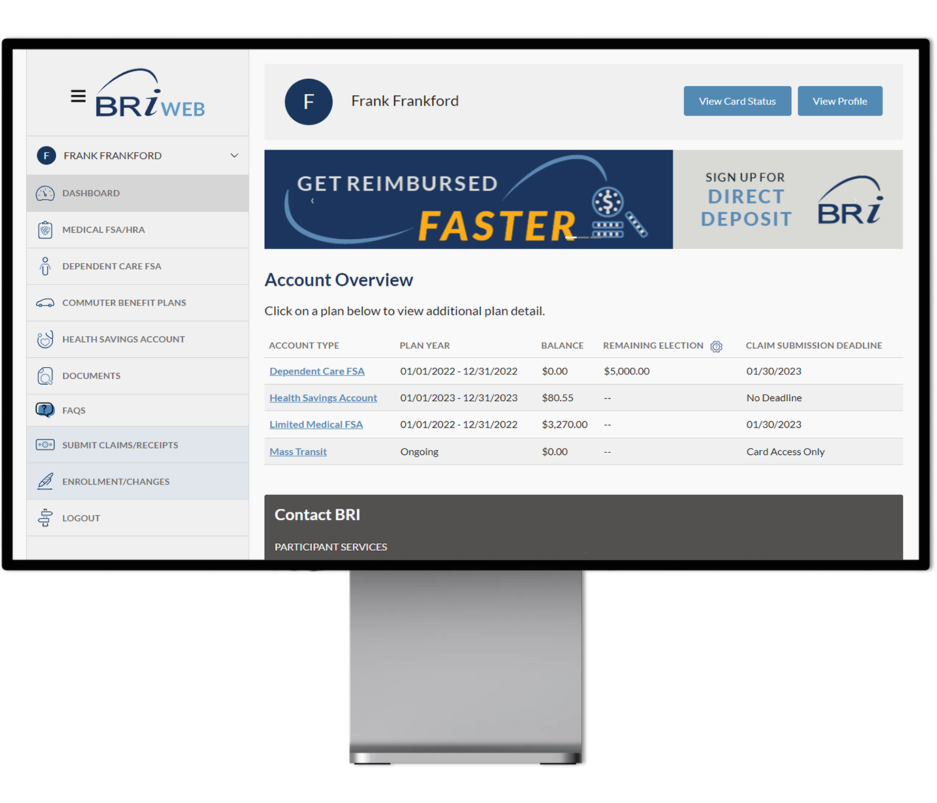


BRIWEB Participant Portal
Company Code: divcom
Review account balance(s) and transactions
Set up direct deposit and balance alerts
Update contact information
Access plan documents and deadlines
…and more!
How to Log In
Go to BenefitResource.com
Click on EMPLOYEE under the Secure Login
If you have not logged in before, choose Register an Account. You will need your Company Code & possibly your Member ID.
Company Code: divcom
For additional information, visit BenefitResource.com/resources/briweb
Notes:
We’ve mentioned BRIWEB a few times throughout this presentation, so let’s go over what that is. BRI provides you with access to a secure BRIWEB participant portal. This site will allow you to review your account balances and transaction details. It is also where you can go to submit claims, resolve receipt requests, set up direct deposit, access your plan documents, and more. You can access the portal by going to benefitresource.com and clicking the login button, then selecting the “Employee” option.
We really encourage you to set up and register an account so you can easily access your account balance and key deadlines from your plan right on the main Dashboard. And in the Documents section, you can access your Plan Highlights for your FSA, which detail the specific plan setup and other details related to your employer-sponsored flexible spending account. This will allow you to better understand the plan specifics including plan year dates, election limits, and the time frames for using the funds in your account.
The first time you arrive at BRIWEB, you will need to select “Register an Account”. For registration, you will need the Company Code provided by your employer as well as your first and last name, date of birth, and home zip code. If the system cannot identify you from that information, you will also need to provide your Member ID. This is a unique ID selected by your employer, such as your social security number, employee ID number, or a combination. As part of the registration process, the custom login ID and password you create will be used to access both BRIWEB and the BRIMOBILE app.

Slide 15
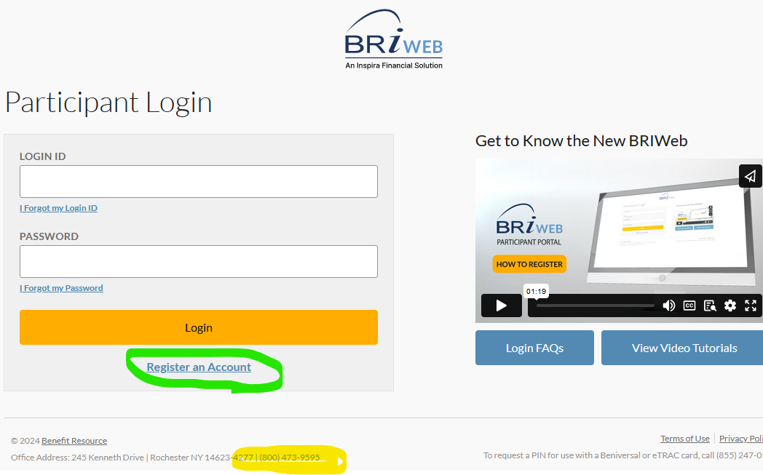
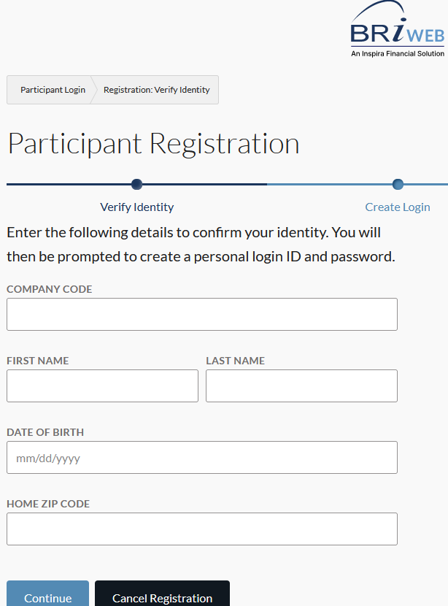
Registering - Participant Portal
www.benefitresource.com click login - Employee Company Code: divcom

Slide 16
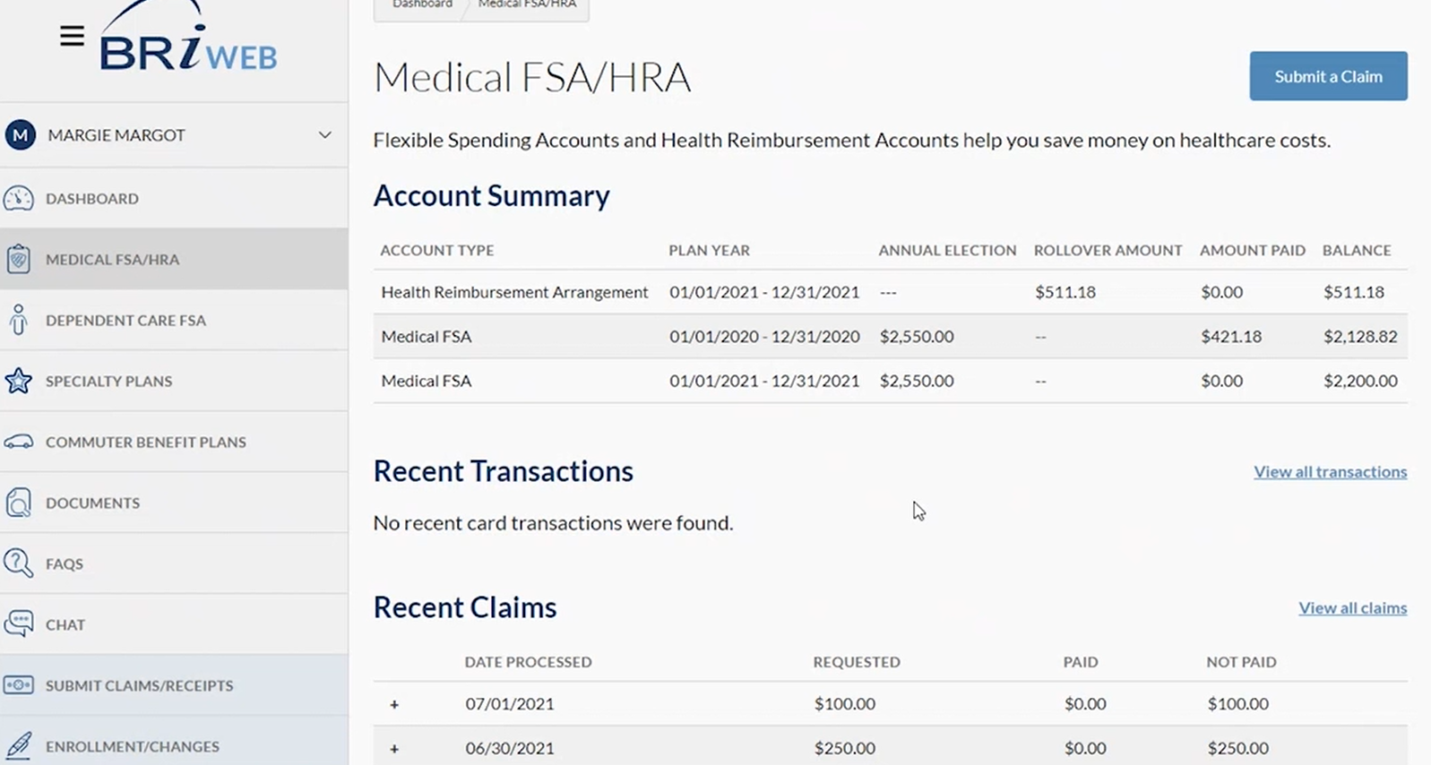
Participant Portal

Slide 17
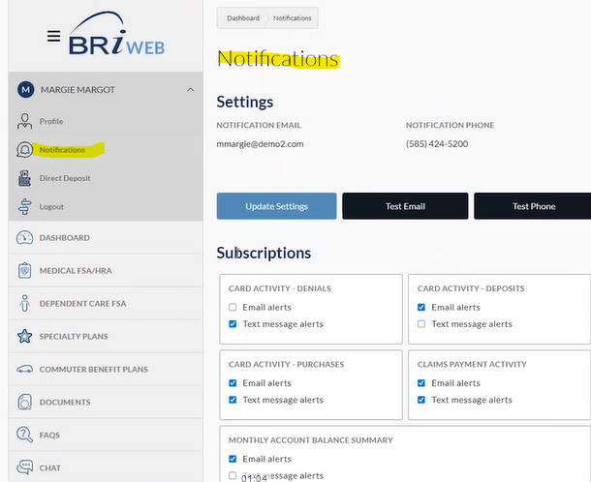
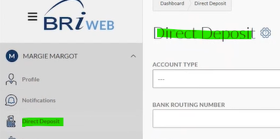
Direct Deposits & Notifications
Claim Reimbursements
  Receive a check (default) or
  Direct deposit which is quicker.

Slide 18

Use Your Card at Qualified Merchants
BRI has partnered with FSA Store to provide you with convenient access to FSA-eligible items without submitting receipts. You have two ways to shop:
Visit FSAstore.com
Use your Beniversal Card at checkout
Login to BRIWEB
Select the “Shop FSAstore.com” tab.
Notes:
You can also spend your Medical FSA funds on Medical items available through the FSA Store. There are two ways to shop. You can go to FSA store.com and use your Beniversal Card when checking out. Or, you can also take advantage of FSA Direct Pay through BRIWEB. FSA Direct Pay is an integrated payment option that allows you to make purchases directly from BRIWEB. The great thing about shopping through the FSA Store is you’ll never need to follow-up with BRI by providing a receipt. But, let’s talk about situations in which that needs to occur.

Slide 19

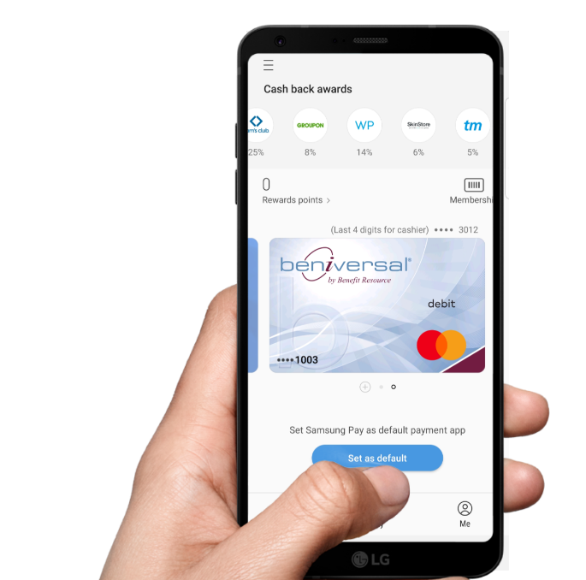

Digital Wallets
  The Beniversal Prepaid Mastercard is available on:
    HOW IT WORKS:
    Add Beniversal card to Google Pay, Apple Pay, or Samsung Pay.
    At a contactless terminal, open the digital wallet app on your phone.
    Select your Beniversal card as the payment method.
    Hold your phone approximately ½ inch away from the terminal.
    Terminal will light-up or ding indicating the transaction was successful.
GREAT NEWS! All participants can add cards to digital wallets.
There is no client set-up or participant re-carding required.
Notes:
To make the most of your HSA from BRI, take advantage of the options available with your Beniversal Card – the first being its digital wallet capabilities. You can load your digital wallet into Apple Pay, Google Pay, or Samsung Pay so that when a contactless terminal is available, you can securely pay for eligible HSA expenses through the Beniversal card right from your phone.

Slide 20
Convenient Participant Support
PHONE: (800) 473-9595
HOURS:
Monday - Friday, 8am - 8pm (EST)
Support available in English and Spanish
ONLINE LIVE CHAT:
BenefitResource.com
Available through the BRIWEB employee login
EMAIL:
ParticipantServices@BenefitResource.com
Notes:
And finally, if you ever need assistance with your HSA, BRI offers several convenient ways for you to reach out to our Participant Services Department. You can reach us Monday through Friday 8 a.m. Until 8 p.m. Eastern Time by phone, via online chat at BRIWEB, or by email.

